Slide 1
Event Regularity and Irregularity in a Time Unit
Lijian Wan, Tingjian Ge
lwan@cs.uml.edu, ge@cs.uml.edu
University of Massachusetts Lowell

Slide 2

Outline
Motivation
Regular Model and Regularity Score
Further Enhancements
Experiments
Notes:
In this presentation, I am going to talk about the motivation of our work first. Then I will show two algorithms we designed to solve the problem we identified. After that I will talk about how we improve the performance of our algorithms. At last I am going to show some experiment results of our work.

Slide 3
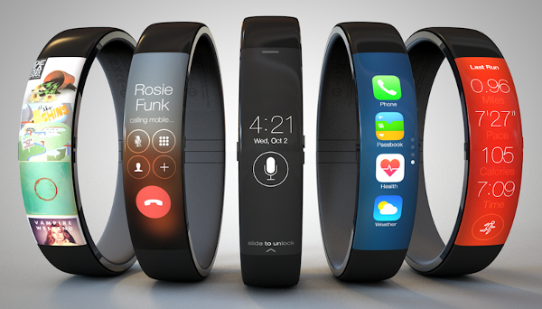
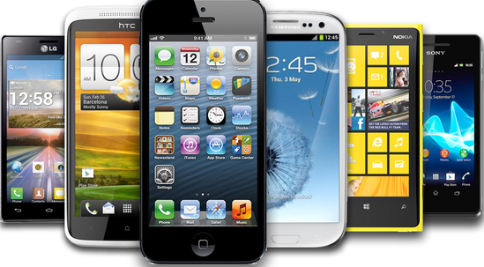
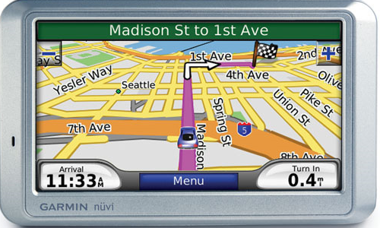
The Need to Make Use of Sensors and Data
SmartBand
Smart Phones
GPS
Notes:
Let’s see the motivation first. We are living in the so called big data era where sensors are everywhere. We have smartBand to record our daily activities, GPS to record our location, and even smart phones have lots of sensors in it.

Slide 4
Relational Sequence Data
Wake_up → Shower → Breakfast → Go_to_Work
TIME
6:30 AM
6:45 AM
7:00 AM
7:30 AM
Bed Sensor
Faucet Sensor
Oven Sensor
Door Sensor
1
0
0
0
0
1
0
0
0
0
1
0
0
0
0
1
Notes:
These sensors continue sensing create relational sequence data where one of the attributes is time. Along with any number of other attributes.
Here I am showing a sequence data of a person’s morning activities.
The other four attributes in here represent 4 sensors in a smart house. The first one is bed sensor in a bedroom, the second one is faucet sensor in bathroom, the third one is oven sensor in the Kitchen, the last one is living room door sensor.
These four attributes are binary attributes. The value 1 in here means the sensor is active at that time.
Each event in each timestamp, we call it a tuple. Each tuple in the sequence describes the state at an instant of time, which often implies the event, activity, or action that is happening.
Certain events and activities often have some patterns within a time unit(typically a day or the duration of a process), and the same pattern is repeated periodically over many time units. It is useful to find out the model of such regularity, and to identify irregular or unusual events when they happen. Let us look at some example.

Slide 5
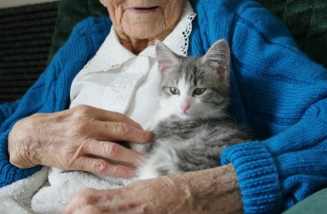
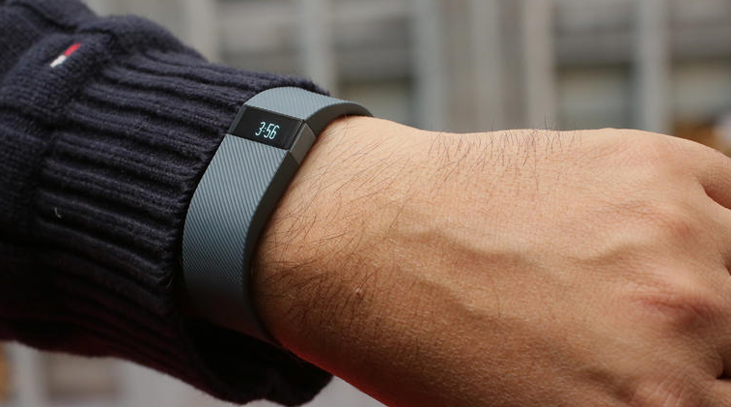

Example
Model:
Wake_up→Shower→Breakfast→Newspaper→TV→Outside→Home
Irregular Events:
Wake_up→Shower→Shower→Shower→Shower→
Notes:
Elderly people (or persons with autism) who live alone often lead a dangerous life. If they fall down on the floor, or pass out in the bathroom, no one may notice it for a long time. It would be useful to have software program automatically and continuously recording the location, movement, and other signals of the person, Since these people’s normal daily activities are usually simple, we can easily built a regular model of their routine and find irregular events as soon as they happen. Many lives could be saved from such continuous automatic monitoring.

Slide 6
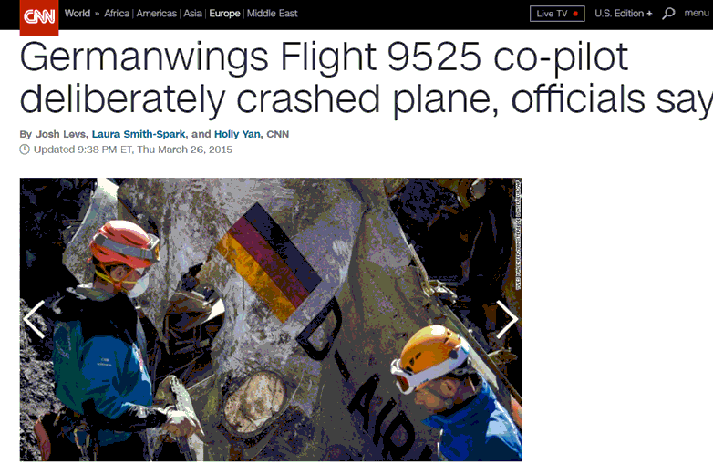
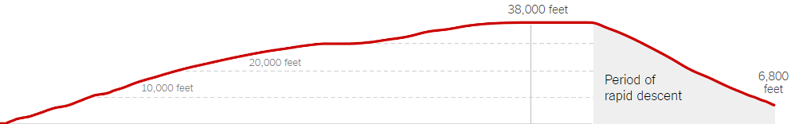
Example
Lubitz seemed to be toying with the airplane's settings on the earlier flight from Dusseldorf to Barcelona, programming it for a sharp descent multiple times.
Notes:
On March 24, 2015, a Germanwings flight copilot Lubiz crashed airplane, killing all 150 people on board. It turned out that the copilot had some mental issue. He seemed to be toying with the airplane's settings on the earlier flight from Dusseldorf to Barcelona, programming it for a sharp descent multiple times. The airline company technically could have known about these unusual operation data, but only if they had looked at the flight data and find the irregular operations, the tragedy could have been prevented.

Slide 7
Outline
Motivation
Regular Model and Regularity Score
Further Enhancements
Experiments
Notes:
Now let’s see the algorithms we designed to solve the problem we just mentioned.

Slide 8





Our Proposal
$$\text{s}\text{1}$$
a
b
c
d
e
$$\text{s}\text{2}$$
b
c
d
g
f
$$\text{s}\text{3}$$
b
g
f
d
b
c
d
$$\text{s}\text{4}$$
b
g
f
d
$$\text{s}\text{i}$$
0.5
0.5
0.9
0.001
g
f
d
h
Notes:
Given a set of relational sequence data. First we want to build a regular model based on it. Then for a new sequence, we will calculate the regularity score of each event in the sequence, an further we can get the regularity score of the whole sequence. Eventually we are able to find the irregular event and irregular sequence by checking the score.

Slide 9
Event Hierarchy Tree
kitchen/
food activities
preparing meal
washing dishes
eating/
drinking
making
beverage
eating
meal
making tea
making
coffee
breakfast
lunch
dinner
Notes:
Before building a regular model, we first did a data prepossessing which is building an event hierarchy tree.
The idea is that a new generalized higher-level event incorporates multiple more specific events, hence allowing us to model variations of the same general event. For example, the events “making coffee” and “making tea” can be generalized to a higher level event “making beverage”, even though “making beverage” is not an event in the original sequence set. Then making beverage and eating meal can be generalized into eating/drinking then further be generalized to kitchen or food activities.

Slide 10
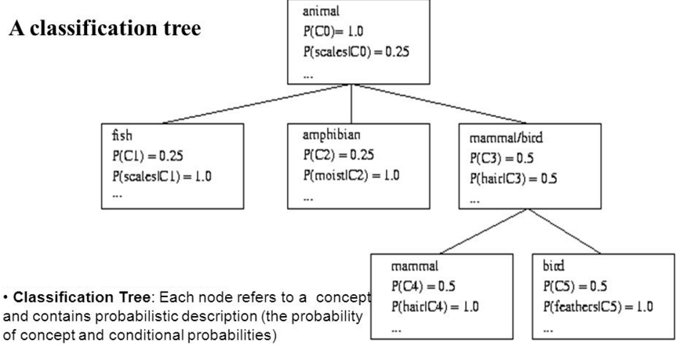
Conceptual Clustering—COBWEB
Notes:
To build the hierarchy tree. We use a Conceptual clustering method, in particular, cobweb in our work.
COBWEB is a machine learning algorithm for unsupervised classification. It incrementally organizes observations into a classification tree. Each node in a classification tree represents a class (concept) and is labeled by a probabilistic concept that summarizes the attribute-value distributions of objects classified under the node.
This a an example of a classification tree based on animal data.
As you can see, in the leaf node we have, fish, amphibian, bird and mammal. Then bird and mammal can be merged to an internal node mammal/bird, because of the similarity of them. Then all of the nodes can be generalized to a root node animal.

Slide 11
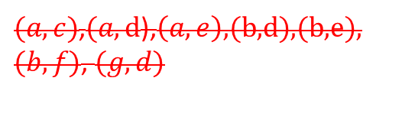




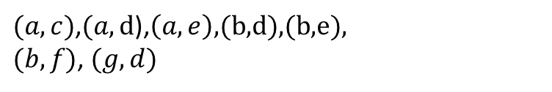

Building a Regular Model
$$\text{s}\text{1}$$
M
M
M
M
a
b
c
d
e
$$\text{s}\text{2}$$
M
M
b
c
d
Event pairs:
$(a,b)$,$(b,c\text{),}\left(b,g\right)\text{,}(c,d)$,$(g,f)$,$(d,e)$,$\left(f,d\right).$
$$\text{s}\text{3}$$
M
M
M
$(a,c)$,$(a,\text{d}\text{),}\left(a,e\right)\text{,(}\text{b}\text{,}\text{d}\text{),(}\text{b}\text{,}\text{e}\text{),}$
$(b,f)$, $(g,d)$
b
g
f
d
$(a,c)$,$(a,\text{d}\text{),}\left(a,e\right)\text{,(}\text{b}\text{,}\text{d}\text{),(}\text{b}\text{,}\text{e}\text{),}$
$(b,f)$, $(g,d)$
$$\text{s}\text{4}$$
M
M
M
b
g
f
d
Notes:
After building the event hierarchy tree, we then start to build our regular model.
The input is a set of relational sequence data. Each event in each sequence will send a message to it’s neighbor, the message will propagate to the last node of the sequence. By doing this, we will have some event pairs. However some of them are redundant because of the message reachability. For example a sends a message to c is same to a sends the message to b first and then b to c. Therefore in here wo don’t consider these redundant event pairs.

Slide 12





Building a Regular Model
Event pairs:
$(a,b)$,$(b,c\text{),} \left(b,g\right)\text{,} (c,d)$, $(g,f)$,$(d,e)$, $\left(f,d\right).$
Sequence:
$$\text{a} \text{b} \text{c} \text{d} \text{e}$$
Bitmap for counting event pair
$$\text{b} \text{c} \text{d}$$
 | a | b | c | d | e | f | g
a
b
c
d
e
f
g
$$\text{b} \text{g} \text{f} \text{d}$$
$$\text{b} \text{g} \text{f} \text{d}$$
1000
1100
1100
0011
1000
0011
0011
Notes:
After we get the event pairs, we will build a bitmap to count the number of the event pairs. In this example each cell contains 4 bits which represent 4 sequence. For the first event pair ab, it only appears in the first sequence, therefore we set the bit to 1000. For event pair bc, it appears in the 1st and 2nd sequence, therefore we set the bit to 1100. Then we keep doing this until all event pairs are set in the bitmap.

Slide 13
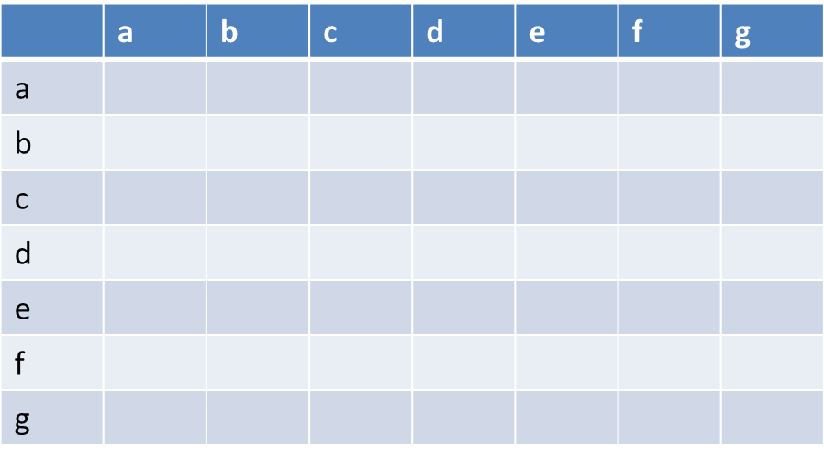


Building a Regular Model
Threshold parameter: $\frac{1}{2}$
$\left(a,b\right)$: $1≤4∗\frac{1}{2}$
$\left(b,c\right)$: $2≥4∗\frac{1}{2}$
$\left(b,g\right)$: $2≥4∗\frac{1}{2}$
$\left(c,d\right)$: $2≥4∗\frac{1}{2}$
$\left(d,e\right)$: $1≤4∗\frac{1}{2}$
$\left(f,d\right)$: $2≥4∗\frac{1}{2}$
$\left(g,f\right)$: $2≥4∗\frac{1}{2}$
1000
1100
1100
0011
1000
0011
0011
Notes:
Our next step is to find out the qualified event pairs from the bitmap. Let’s assume the frequency threshold parameter is ½. We can easily find the pairs that satisfy the threshold from the bitmap.

Slide 14

Building a Regular Model
$\left(a,b\right)$: $1≤4∗\frac{1}{2}$
$\left(b,c\right)$: $2≥4∗\frac{1}{2}$
$\left(b,g\right)$: $2≥4∗\frac{1}{2}$
$\left(c,d\right)$: $2≥4∗\frac{1}{2}$
$\left(d,e\right)$: $1≤4∗\frac{1}{2}$
$\left(f,d\right)$: $2≥4∗\frac{1}{2}$
$\left(g,f\right)$: $2≥4∗\frac{1}{2}$
g
f
b
c
d
Notes:
We then use these satisfied event pairs to build a regular model. The next we want to do it to calculate the regular score of the event and the sequence.

Slide 15




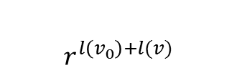


Regular Score and Irregular Events
Irregular
$${0.8}^{1+2}∗{0.8}^{2+3}$$
0.01
$${0.8}^{1+2}$$
$${0.8}^{2+3}$$
Discount factor: $r=0.8$
$$\text{s}\text{1}\text{:}$$
a
b₁
c₁₂
d
Weight of an edge:
$$r^{l\left(v_{0}\right)+l(v)}$$
$\text{M}$ :
a
B
C
Hierarchy Tree:
E
C
B
d
a
C₁
C₂
b₁
b₂
b₃
C₁₁
C₁₂
Notes:
Having had the regular model. Our next step is to calculate the regularity score and find irregular event.
Let’s assume we have a sequence s1: and regular model. The discount factor is 0.8. And the formula we used to calculate the regularity score of an edge is this.
Since in the event hierarchy tree, lower event is more specific however higher event is more general and unspecific, so the lower the event is the higher the score will be. That’s why we set the discount factor between 0 and 1.
Let’s se how we calculate the score.
We have event pair a b1 in the sequence and a captical B in the regular model. In the Hierarchy three, Captical B is the parent of the leaf node b1. Therefore it is level two. So the score will be 0.8 to the power of 1 plus 2. Similarly we can calculate the score of b1 to c12 and so on. The event regularity score is the product of this node’s connecting edges score. And for the first and last event, the score is just the score of the edge connecting to it.
After we calculating all the event regularity score, we can easily find for those events whose message receives no respond or who does not respond to anyone else’s ping will have a pretty low score. Then we call them irregular events.

Slide 16
Outline
Motivation
Regular Model and Regularity Score
Further Enhancements
Experiments
Notes:
We then designed two enhancement methods to improve the performance of our algorithms.

Slide 17

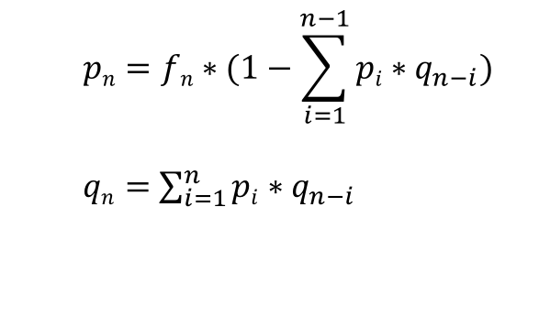


Further Enhancement—Early Stop
$\text{p}\text{n}$: $Prob.$ an edge to an event n time steps later
a
b
c
n
z
$\text{q}\text{n}$ : $Prob.$ a path to an event n time steps later
$fn:Prob.(s\left[i\right],s[i+n])$ is frequent
Two Functions:
$$pn=fn∗(1−\sum_{i=1}^{n−1}{pi∗q_{n−i}})$$
$qn=$ $\sum_{i=1}^{n}{pi∗q_{n−i}}$
The pair is frequent and there is no path
with multiple edges between two nodes
A path of n hops is subdivided according to
the number of hops of the first edge in the
path
Notes:
The basic idea is as a message propagates a long way, the chance that it will form new edges in the graph becomes very small. This is because it is more likely to have a “path” between two farther nodes as the number of possible paths increases. Therefore, when the edge probability becomes low enough, we may stop the lengthy message propagation process.
We defined two functions to calculate the probability.
The 1st function tells that there is an edge to a vertex n hops away, if and only if.
Similarly the second one shows the case of existing
It is not hard to see that, by applying equations 2 and 1 alternately, we can iteratively obtain all qi and pi. We can stop the process, as well as the algorithm, when pn is small enough.

Slide 18

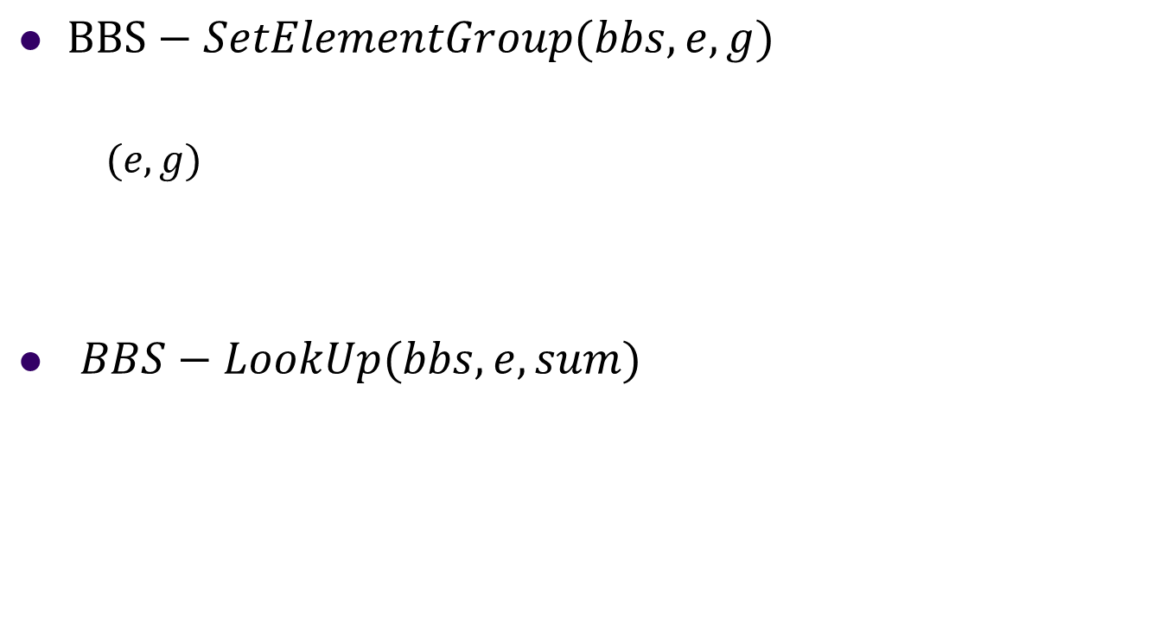



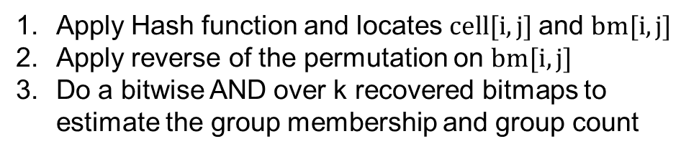
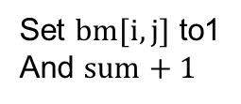
Further Enhancement—BBS
$BBS−SetElementGroup(bbs,e,g)$
$(e,g)$
$BBS−LookUp(bbs,e,sum)$
Permutation of m bits
Hash Function
$$permi$$
$$hi(e)$$
$ri$:
Set $bm[i,j]$ to1
And $sum+1$
$$logw=column j$$
Apply Hash function and locates $cell[i,j]$and $bm[i,j]$
Apply reverse of the permutation on $bm[i,j]$
Do a bitwise AND over k recovered bitmaps to estimate the group membership and group count
Notes:
Recall that, in the BUILDREGULARMODEL algorithm, we need to maintain a bitmap for each ordered pair (u; v) in S, which may be very space consuming when the number of events is large
We devise a novel approximation technique, which we call blended bitmap set to solve this problem.
The basic idea is as follows. Whenever an element-group pair (e; g) arrives (meaning element e is in group g), we apply each of the k hash functions hi to e and get the hash value be hi(e). We take log w bits from hi(e), which corresponds to a column (say, column j) in the ith row. Then we set the group information (group g) in the bitmap of cell (i; j), denoted as bm[i; j]. However, we do not directly set bit g of bm[i; j]. Instead, we apply a random permutation permi over the m bits,
where permi is also determined by hi(e) (by taking a few bits from it). Suppose bit g maps to bit g0 with this permutation. Then we set bit g0 of bm[i; j]. This is done for each of the k hash functions (k rows).
The query/lookup function on a BBS also first applies each of the k hash functions and locates cell (i; j) and bm[i; j] in the same way. Then it applies the reverse of the permutation perm-1i on bm[i; j] (for each 1 i k). This gets the original bitmaps back. Then we do a bitwise AND over the k recovered bitmaps to estimate the group membership and group count. The bit permutations in BBS operations are for balancing the collision probabilities at each bit position (robust to group size skewness) to accurately estimate group counts.

Slide 19
Outline
Motivation
Regular Model and Regularity Score
Further Enhancements
Experiments
Notes:
Let’s see some of our experiment results.

Slide 20
Datasets
2 real world datasets
Smart House Dataset
77 and 84 sensor data collection boards equipped with reed switch sensors were installed in two single-person apartments collecting data about human activity for two weeks.
Microsoft Research GPS Dataset
GPS trajectory dataset collected in (Microsoft Research Asia) Geolife project by 182 users over five years
Notes:
There are 77 and 84 sensors that were installed in everyday objects such as drawers, refrigerators, containers and so on. They collect 2 weeks indoor human activities. Activities associated with the sensor signals are labeled in the data.

Slide 21
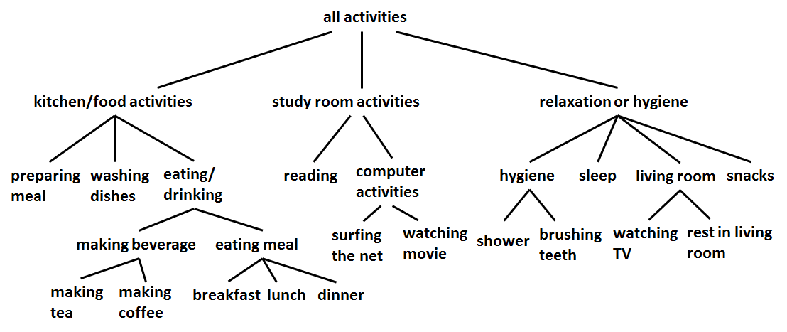
Results—Event Hierarchy Tree
Notes:
This is one of event hierarchy trees we used in our experiment.

Slide 22
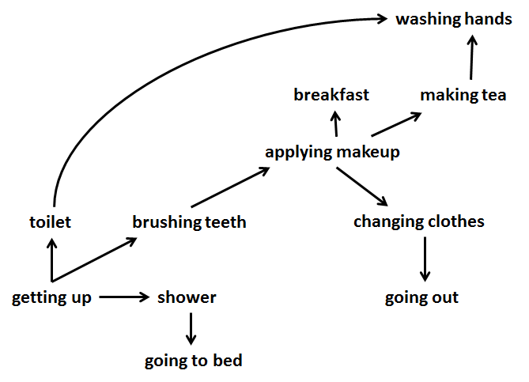
Results—Regular Model
Notes:
This is a subgraph of regular model we learned from the hybrid data which is similar to smart house dataset. We only show the leaf to leaf edges in here, but our regular model also includes event vertices at various levels of event hierarchy produced by cobweb.

Slide 23
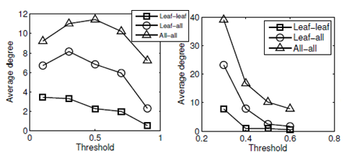
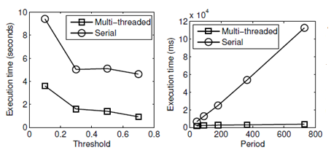
Results
Notes:
Figure 1 and 2 shows the relation between leaf degree and the threshold parameter. As threshold increase, the degree will decrease because fewer event pairs are qualified for edges.
The last two figures in this slide shows our algorithm can run on a multicore processor which will save the running time.

Slide 24
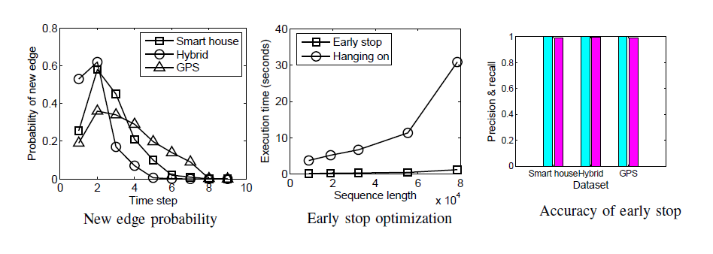
Results

Slide 25
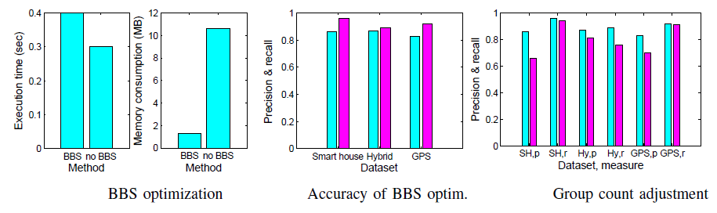
Results
Notes:
These figures in here shows with BBS we can save 8 MB memory and the execution time only increase 0.1 second. The accuracy is pretty high in here too.

Slide 26
Conclusion
Finding event regular model and detecting irregular events in a time unit is needed in modern applications.
We use conceptual clustering to build an event hierarchy tree.
An easily parallelizable message passing framework algorithm to build a regular model and an algorithm method to compute regularity.
Time and space saving methods.
Notes:
We identified a new problem that is
We design
We use two enhancement method to improve performance. And the experiments shows that they saved both time and space.

Slide 27
Thank you! Questions?

